Slide 1

A Hierarchical Neural Autoencoder for Paragraphs and Documents
Authors: Jiwei Li,
Minh-Thang Luong and
Dan Jurafsky
Stanford University.

Slide 2
Problem Statements
Natural Language Generation ( Text generation)
Architectures of Autoencoder using LSTM
Evaluation and Efficiency

Slide 3
Introduction
Generation of coherent text is a main task in NLP.
Variety of theories exists to capture the coherent relationships between texts.
Rhetorical Structure Theory (Mann and Thompson, 1988)
Discourse Representation Theory (Lascarides and Asher, 1991)
Applying these theories are difficult because of complexity and large volumes.
To understand, one has to understand the communicative function of each unit, and the role it plays within the context that encapsulates it and recursively go all the way up for the entire text.
Identifying increasingly sophisticated human-developed features may be insufficient for capturing these patterns.
Developing neural network based alternatives has also been difficult.But succeeded in capturing good amount of aspects of coherent sentence structure (Ji and Eisenstein, 2014; Li et al., 2014; Li and Hovy, 2014).
Recent LSTM models (Hochreiter and Schmidhuber, 1997) have shown powerful results on generating meaningful and grammatical sentences in sequence generation tasks like machine translation (Sutskever et al., 2014; Bahdanau et al., 2014; Luong et al., 2015) or parsing (Vinyals et al., 2014).

Slide 4
2. Architecture
The main focus is on the component task of training a paragraph(document)-to-paragraph (document) autoencoder.
Then it is used to reconstruct the input text sequences.
Three Models of Autoencoder is presented with different levels of complexity.
Standard LSTM
Hierarchical LSTM
Hierarchical LSTM with Attention

Slide 5
LSTM( Long-Short Term Memory)

Slide 6
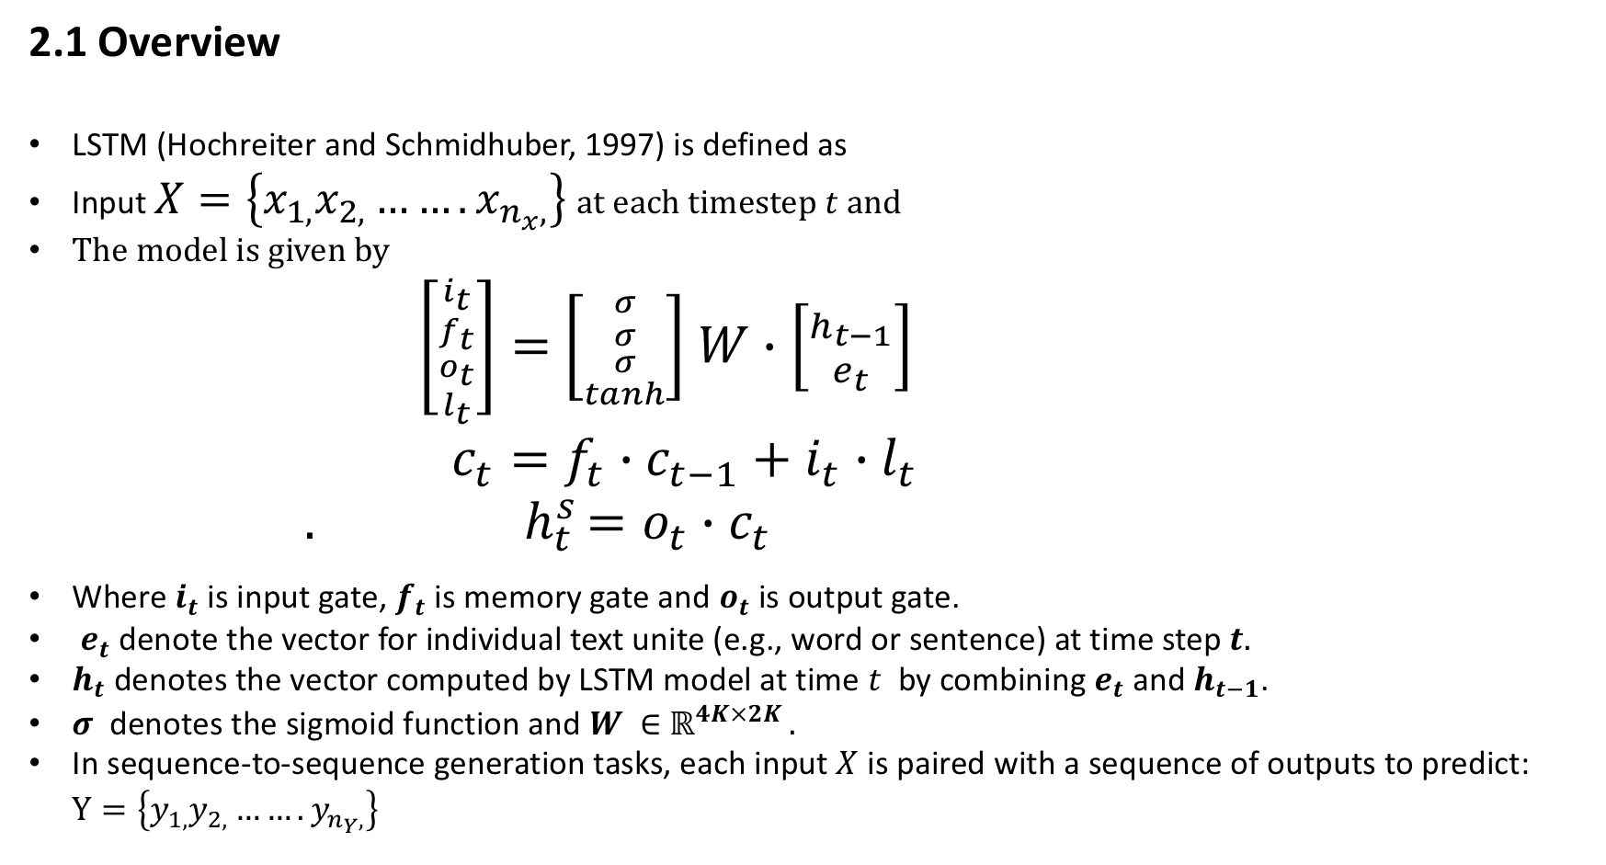
2.1 Overview
LSTM (Hochreiter and Schmidhuber, 1997) is defined as
Input $X=\left\{x_{1,}x_{2,}…….x_{n_{x},}\right\}$ at each timestep $t$and
The model is given by
$\left[{{i_{t} \atop f_{t}} \atop {o_{t} \atop l_{t}}}\right]=$ $\left[{{σ \atop σ} \atop {σ \atop tanh}}\right]$ $W∙\left[{h_{t−1} \atop e_{t}}\right]$
$c_{t}=f_{t}∙c_{t−1}+i_{t}∙l_{t}$
${. h}_{t}^{s}=o_{t}∙c_{t }$
Where $i_{t}$ is input gate, $f_{t}$ is memory gate and $o_{t}$ is output gate.
$e_{t}$denote the vector for individual text unite (e.g., word or sentence) at time step $t.$
$h_{t}$ denotes the vector computed by LSTM model at time $t$ by combining $e_{t}$ and $h_{t−1}$.
$σ$ denotes the sigmoid function and $W ∈$ $ℝ^{4K×2K }.$
In sequence-to-sequence generation tasks, each input $X$ is paired with a sequence of outputs to predict: $Y=\left\{y_{1,}y_{2,}…….y_{n_{Y},}\right\}$

Slide 7
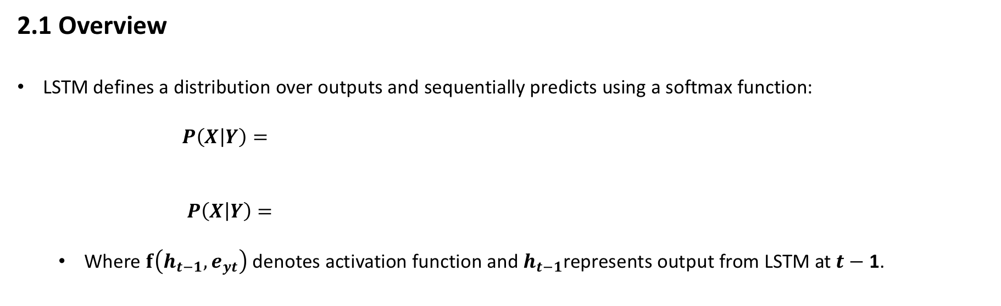
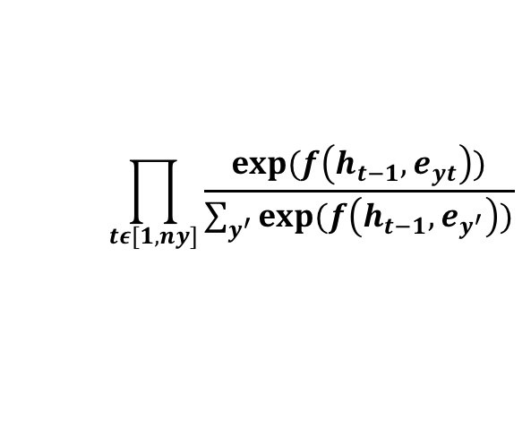
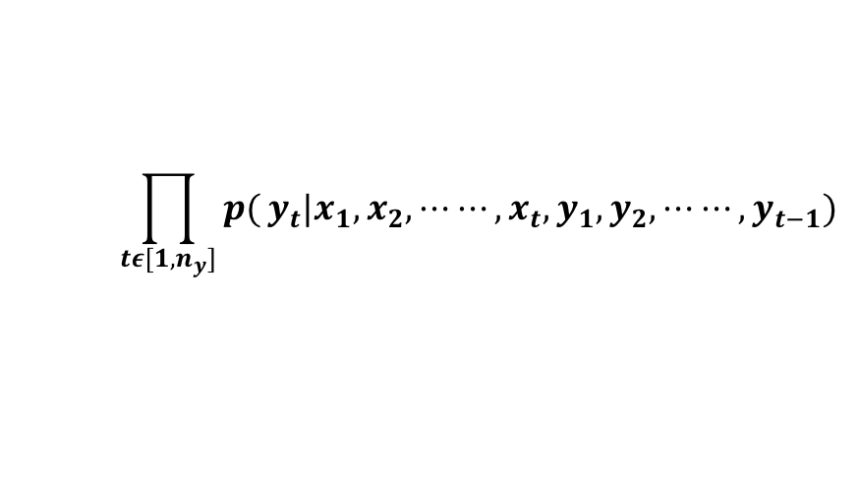
2.1 Overview
LSTM defines a distribution over outputs and sequentially predicts using a softmax function:
$P\left(X | Y\right)=$
$P\left(X | Y\right)=$
Where $f\left(h_{t−1},e_{yt}\right)$ denotes activation function and $h_{t−1}$represents output from LSTM at $t−$ 1.
$$\prod_{tε[1,n_{y}]}{p(}y_{t}|x_{1},x_{2},⋯⋯,x_{t},y_{1},y_{2},⋯⋯,y_{t−1})$$
$$\prod_{tε[1,ny]}{\frac{exp⁡(f\left(h_{t−1},e_{yt}\right))}{\sum_{y^{′}}{exp⁡(f\left(h_{t−1},e_{y^{′}}\right))}}}$$

Slide 8
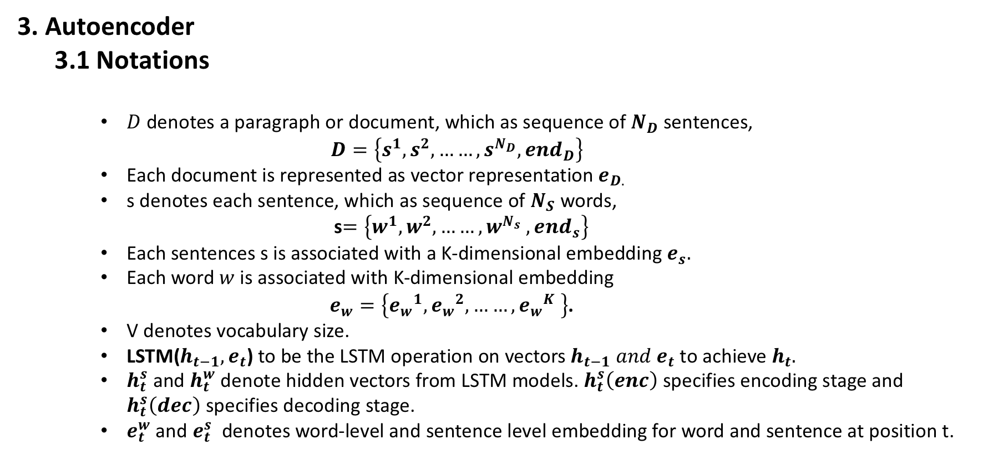
3. Autoencoder
3.1 Notations
$D$denotes a paragraph or document, which as sequence of $N_{D}$ sentences,
$$D=\left\{s^{1},s^{2},……,s^{N_{D}},{end}_{D}\right\}$$
Each document is represented as vector representation $e_{D.}$
s denotes each sentence, which as sequence of $N_{S}$ words,
s$=\left\{w^{1},w^{2},……,w^{N_{s}} ,{end}_{s}\right\}$
Each sentences s is associated with a K-dimensional embedding $e_{s}.$
Each word $w$ is associated with K-dimensional embedding
$e_{w}=\left\{{e_{w}}^{1},{e_{w}}^{2},……,{e_{w}}^{K} \right\}$.
V denotes vocabulary size.
LSTM($h_{t−1},e_{t}$) to be the LSTM operation on vectors $h_{t−1} and e_{t}$ to achieve $h_{t}.$
$h_{t}^{s}$ and $h_{t}^{w}$ denote hidden vectors from LSTM models. $h_{t}^{s}\left(enc\right)$ specifies encoding stage and $h_{t}^{s}\left(dec\right)$ specifies decoding stage.
$e_{t}^{w}$ and $e_{t}^{s}$ denotes word-level and sentence level embedding for word and sentence at position t.

Slide 9
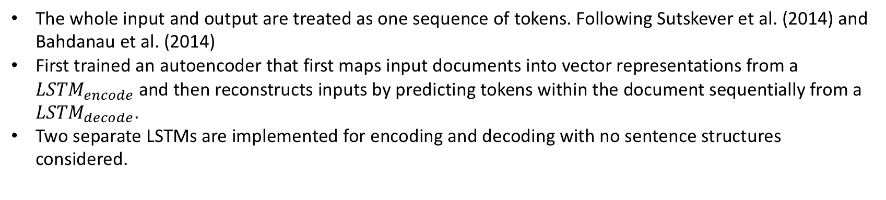
3.2 Model 1: Standard LSTM
The whole input and output are treated as one sequence of tokens. Following Sutskever et al. (2014) and Bahdanau et al. (2014)
First trained an autoencoder that first maps input documents into vector representations from a ${LSTM}_{encode}$ and then reconstructs inputs by predicting tokens within the document sequentially from a ${LSTM}_{decode}$.
Two separate LSTMs are implemented for encoding and decoding with no sentence structures considered.

Slide 10
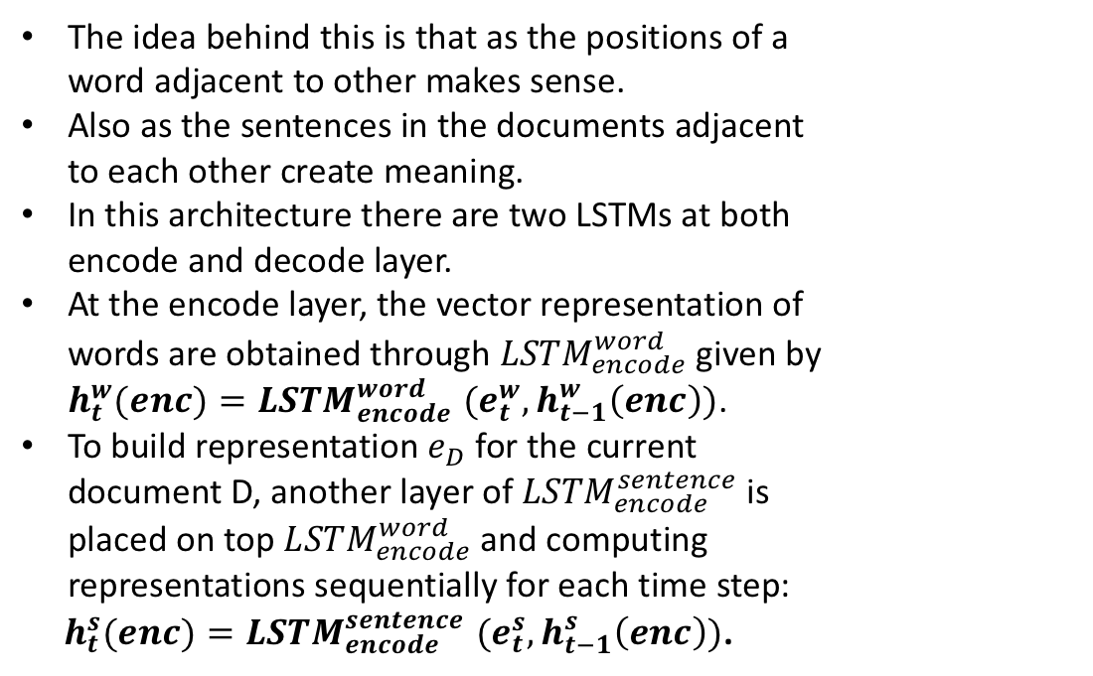
3.3 Model 2: Hierarchical LSTM
The idea behind this is that as the positions of a word adjacent to other makes sense.
Also as the sentences in the documents adjacent to each other create meaning.
In this architecture there are two LSTMs at both encode and decode layer.
At the encode layer, the vector representation of words are obtained through ${LSTM}_{encode}^{word}$ given by $h_{t}^{w}(enc){=LSTM}_{encode}^{word}(e_{t}^{w},h_{t−1}^{w}\left(enc\right))$.
To build representation $e_{D}$ for the current document D, another layer of ${LSTM}_{encode}^{sentence}$ is placed on top ${LSTM}_{encode}^{word}$and computing representations sequentially for each time step:
$h_{t}^{s}(enc){=LSTM}_{encode}^{sentence}(e_{t}^{s},h_{t−1}^{s}\left(enc\right))$.
Hierarchical Sequence to Sequence Model.

Slide 11
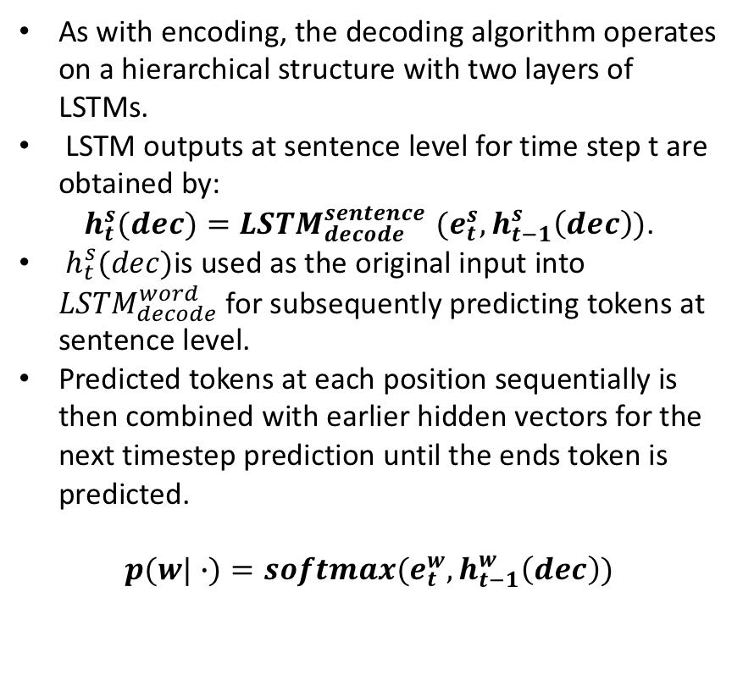
3.3 Model 2: Hierarchical LSTM
As with encoding, the decoding algorithm operates on a hierarchical structure with two layers of LSTMs.
LSTM outputs at sentence level for time step t are obtained by:
$h_{t}^{s}(dec){=LSTM}_{decode}^{sentence}(e_{t}^{s},h_{t−1}^{s}\left(dec\right))$.
$h_{t}^{s}(dec)$is used as the original input into ${LSTM}_{decode}^{word}$ for subsequently predicting tokens at sentence level.
Predicted tokens at each position sequentially is then combined with earlier hidden vectors for the next timestep prediction until the ends token is predicted.
$$p(w|∙)=softmax(e_{t}^{w},h_{t−1}^{w}\left(dec\right))$$
Hierarchical Sequence to Sequence Model.

Slide 12
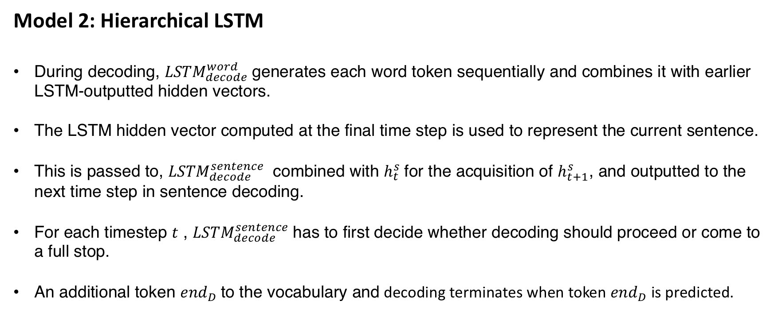
Model 2: Hierarchical LSTM
During decoding, ${LSTM}_{decode}^{word}$generates each word token sequentially and combines it with earlier LSTM-outputted hidden vectors.
The LSTM hidden vector computed at the final time step is used to represent the current sentence.
This is passed to, ${LSTM}_{decode}^{sentence}$ combined with $h_{t}^{s}$for the acquisition of $h_{t+1}^{s}$, and outputted to the next time step in sentence decoding.
For each timestep $t$ , ${LSTM}_{decode}^{sentence}$has to first decide whether decoding should proceed or come to a full stop.
An additional token ${end}_{D}$to the vocabulary and decoding terminates when token ${end}_{D}$ is predicted.

Slide 13
3.4 Model 3: Hierarchical LSTM with Attention
Attention models adopt a look-back strategy by linking the current decoding stage with input sentences in an attempt to consider which part of the input is most responsible for the current decoding state.
This attention version of hierarchical model is inspired by similar work in image caption generation and machine translation (Xu et al., 2015; Bahdanau et al., 2014).
Hierarchical Sequence to Sequence Model with Attention.

Slide 14
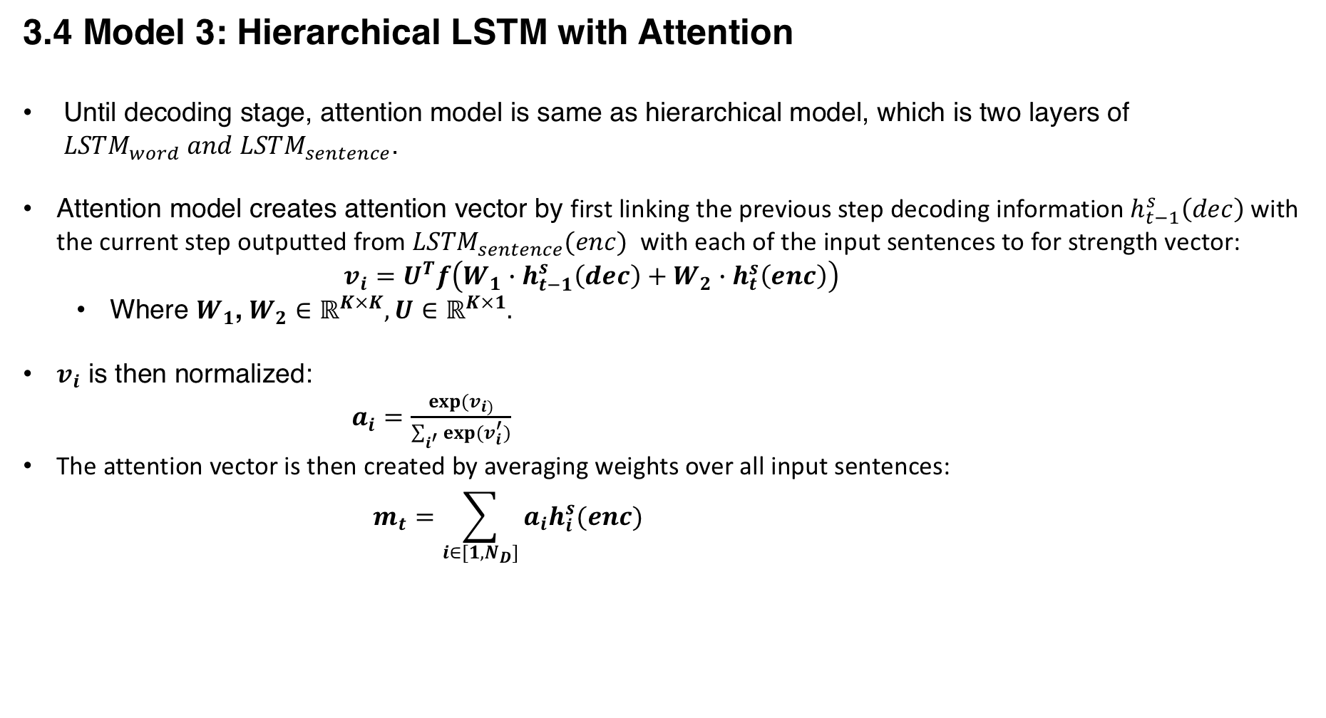
3.4 Model 3: Hierarchical LSTM with Attention
Until decoding stage, attention model is same as hierarchical model, which is two layers of ${LSTM}_{word} and {LSTM}_{sentence}$.
Attention model creates attention vector by first linking the previous step decoding information $h_{t−1}^{s}\left(dec\right)$ with the current step outputted from ${LSTM}_{sentence}(enc)$ with each of the input sentences to for strength vector:
$v_{i}=U^{T}f\left(W_{1}∙h_{t−1}^{s}\left(dec\right)+W_{2}∙h_{t}^{s}\left(enc\right)\right)$
Where $W_{1}$, $W_{2}∈ℝ^{K×K},U∈$ $ℝ^{K×1}.$
$v_{i}$ is then normalized:
$a_{i}=\frac{exp⁡(v_{i)}}{\sum_{i^{′}}{exp⁡(v_{i}^{′})}}$
The attention vector is then created by averaging weights over all input sentences:
$$m_{t}=\sum_{i∈[1,N_{D}]}{a_{i}h_{i}^{s}(enc)}$$

Slide 15
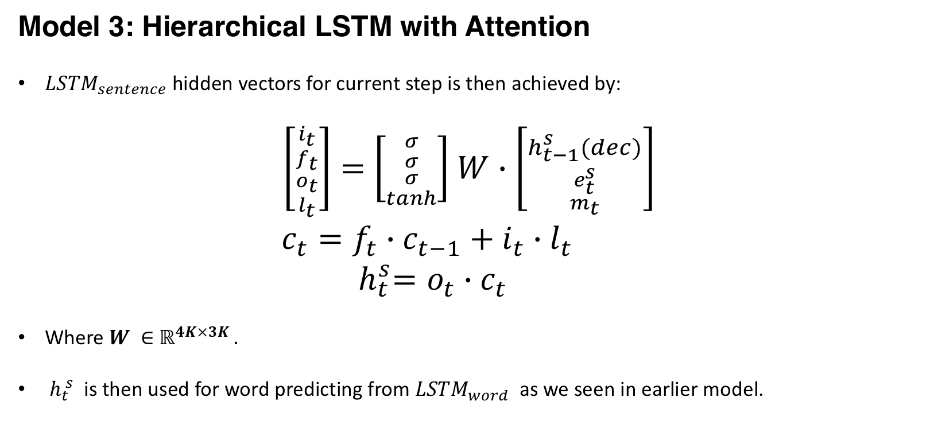
Model 3: Hierarchical LSTM with Attention
${LSTM}_{sentence}$hidden vectors for current step is then achieved by:
$\left[{{i_{t} \atop f_{t}} \atop {o_{t} \atop l_{t}}}\right]=$ $\left[{{σ \atop σ} \atop {σ \atop tanh}}\right]$ $W∙\left[{h_{t−1}^{s}(dec) \atop {e_{t}^{s} \atop m_{t}}}\right]$
$c_{t}=f_{t}∙c_{t−1}+i_{t}∙l_{t}$
${ h}_{t}^{s}=o_{t}∙c_{t }$
Where $W ∈$ $ℝ^{4K×3K }.$
${ h}_{t}^{ s}$ is then used for word predicting from ${LSTM}_{word}$ as we seen in earlier model.

Slide 16
4 Experiments
4.1 Dataset
The proposed autoencoder was trained on two datasets,
A highly domain specific dataset consisting of hotel reviews and
A general dataset extracted from Wkipedia.
Hotel Reviews:
A subset of hotel reviews crawled from TripAdvisor is used.
A vocabulary set consisting of the 25,000 most frequent words.
A special “<unk>” token is used to denote all the remaining less frequent tokens.
Our training dataset is comprised of roughly 340,000 reviews and testing set is comprised of 40,000 reviews.
Wikipedia:
An extracted paragraphs from Wikipedia corpus that meet the aforementioned length requirements is used.
A top frequent vocabulary list of 120,000 words is used.
The training dataset is comprised of roughly 500,000 paragraphs and testing contains roughly 50,000.
W, S and D respectively represent number of words, number of sentences, and number of documents/paragraphs.

Slide 17
4.2 Training Details and Implementation
Earlier works has shown that deep LSTMs work better than shallow ones for sequence-to sequence tasks.
LSTM structure has four layer for encoding and four layer for decoding, each of which is comprised of a different set of parameters.
Each LSTM layer consists of 1,000 hidden neurons and the dimensionality of word embedding's is set to 1,000.
Input documents are reversed.
LSTM parameters and word embeddings are initialized from a uniform distribution between [-0.08, 0.08].
Stochastic gradient decent is implemented without momentum using a fixed learning rate of 0.1.
The learning rate was reduced to half after 5 epochs.
Models were trained for a total of 7 epochs.
Batch size is set to 32 (32 documents).
0.2 dropout rate.

Slide 18
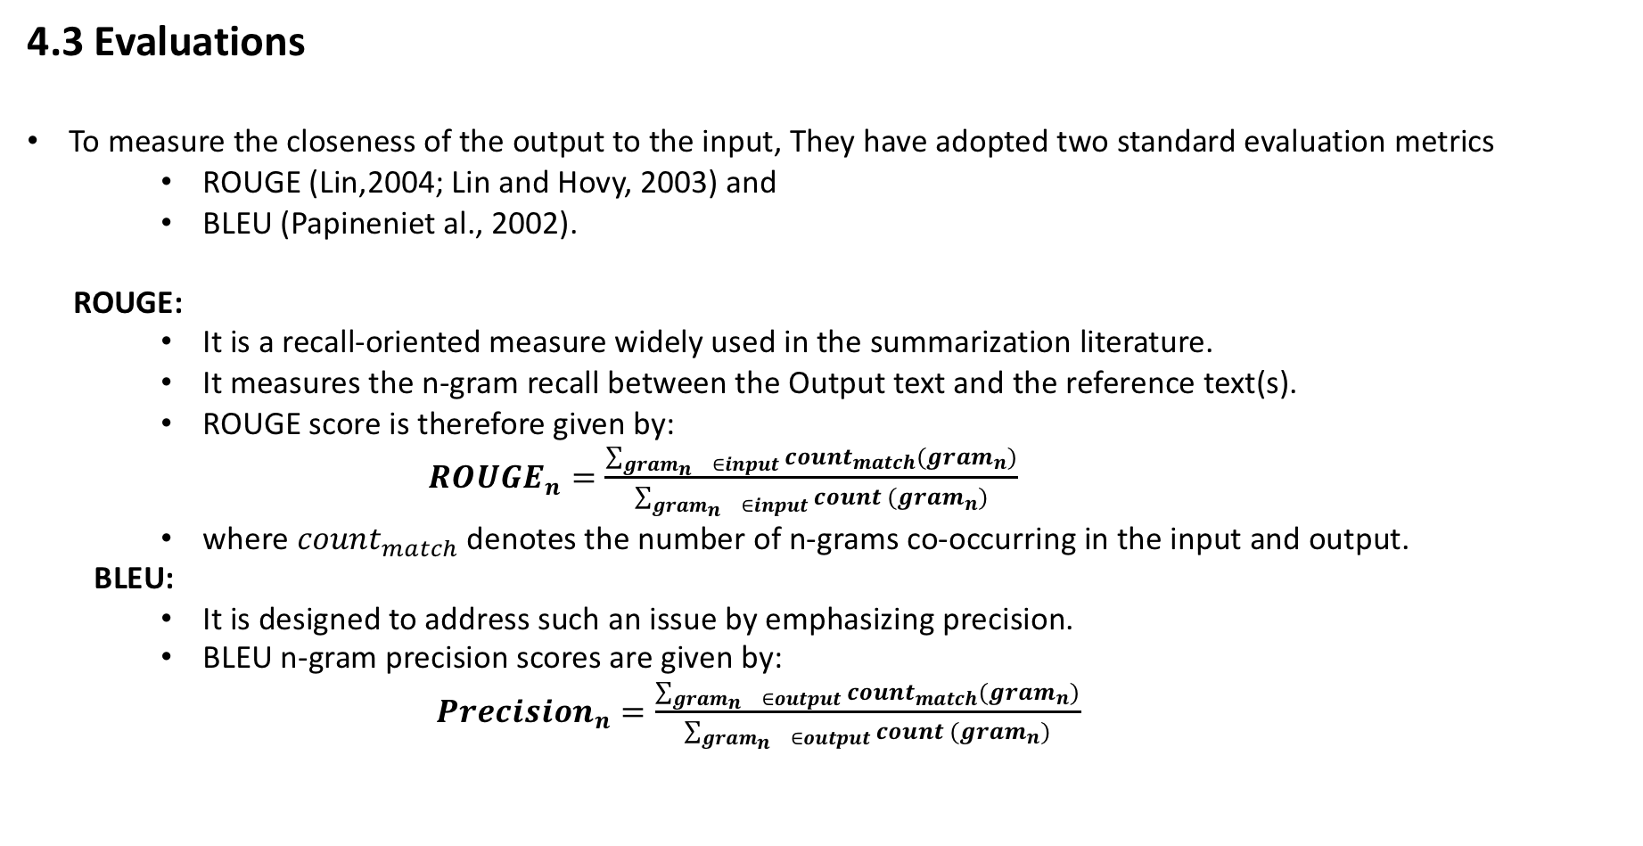
4.3 Evaluations
To measure the closeness of the output to the input, They have adopted two standard evaluation metrics
ROUGE (Lin,2004; Lin and Hovy, 2003) and
BLEU (Papineniet al., 2002).
ROUGE:
It is a recall-oriented measure widely used in the summarization literature.
It measures the n-gram recall between the Output text and the reference text(s).
ROUGE score is therefore given by:
${ROUGE}_{n}=\frac{\sum_{\begin{matrix}{gram}_{n} & ∈input\end{matrix}}{{count}_{match}({gram}_{n})}}{\sum_{\begin{matrix}{gram}_{n} & ∈input\end{matrix}}{count ({gram}_{n})}}$
where ${count}_{match}$denotes the number of n-grams co-occurring in the input and output.
BLEU:
It is designed to address such an issue by emphasizing precision.
BLEU n-gram precision scores are given by:
${Precision}_{n}=\frac{\sum_{\begin{matrix}{gram}_{n} & ∈output\end{matrix}}{{count}_{match}({gram}_{n})}}{\sum_{\begin{matrix}{gram}_{n} & ∈output\end{matrix}}{count ({gram}_{n})}}$

Slide 19
4.3 Evaluations
Coherence Evaluation:
Neither BLEU nor ROUGE attempts to evaluate true coherence.
There is no generally accepted and readily available coherence evaluation metric.
Because of the difficulty of developing a universal coherence evaluation metric.
They have proposed a tailored metric specific to their case.
Based on the assumption that human-generated texts are coherent
They compared generated outputs with input documents in terms of how much original text order is preserved.
A grid evaluation metric similar to the entity transition algorithms in (Barzilay and Lee, 2004; Lapata and Barzilay, 2005).

Slide 20
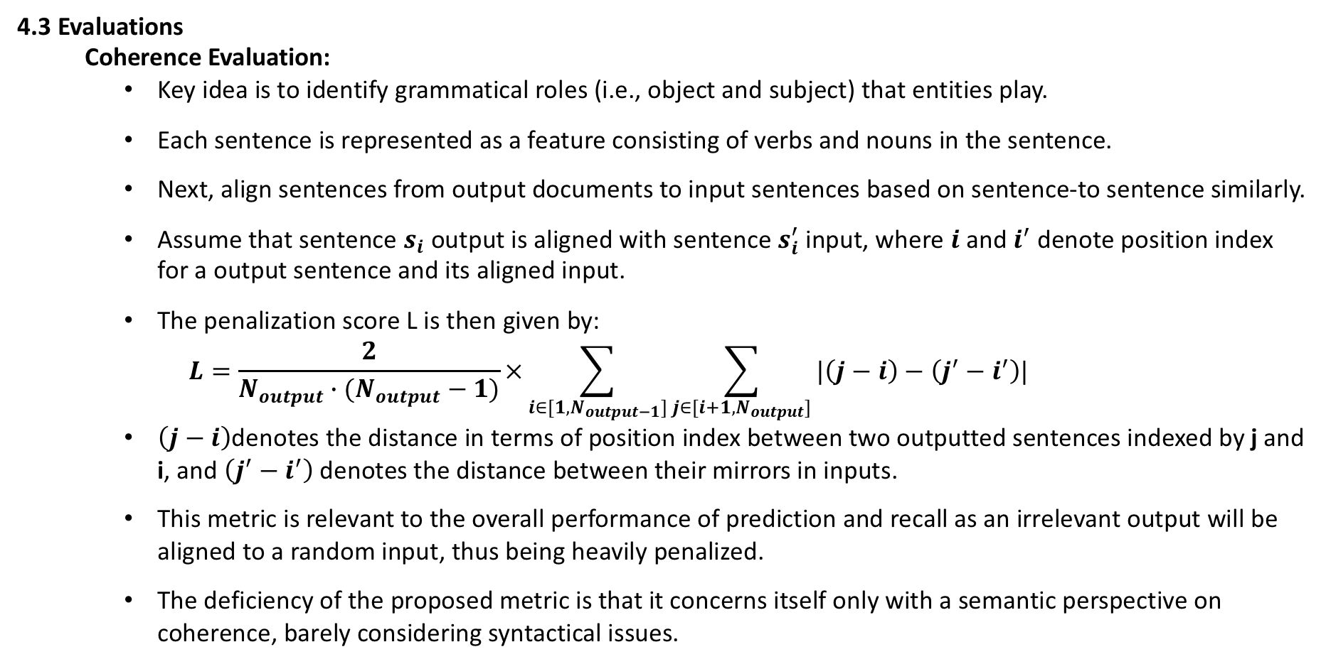
4.3 Evaluations
Coherence Evaluation:
Key idea is to identify grammatical roles (i.e., object and subject) that entities play.
Each sentence is represented as a feature consisting of verbs and nouns in the sentence.
Next, align sentences from output documents to input sentences based on sentence-to sentence similarly.
Assume that sentence $s_{i}$ output is aligned with sentence $s_{i}^{′}$ input, where $i$ and $i^{′}$ denote position index for a output sentence and its aligned input.
The penalization score L is then given by:
$$L=\frac{2}{N_{output}∙(N_{output}−1)}×\sum_{i∈[1,N_{output−1}]}{\sum_{j∈[i+1,N_{output}]}{|\left(j−i\right)−\left(j^{′}−i^{′}\right)|}}$$
$\left(j−i\right)$denotes the distance in terms of position index between two outputted sentences indexed by j and i, and $\left(j^{′}−i^{′}\right)$denotes the distance between their mirrors in inputs.
This metric is relevant to the overall performance of prediction and recall as an irrelevant output will be aligned to a random input, thus being heavily penalized.
The deficiency of the proposed metric is that it concerns itself only with a semantic perspective on coherence, barely considering syntactical issues.

Slide 21
4.4 Results
A summary of our experimental results
Better performances for the hotel-review dataset is observed than the open domain Wikipedia dataset, because of fixed format in documents.
Attention models at the sentence level introduce performance boost over vanilla hierarchical models.
The hierarchical model that considers sentence level structure outperforms standard sequence to- sequence models.

Slide 22
Input-Wiki | apple inc . is an american multinational corporation headquartered in cupertino , california , that designs , develops , and sells consumer electronics , computer software , online services , and personal com - puters . its bestknown hardware products are the mac line of computers , the ipod media player , the iphone smartphone , and the ipad tablet computer . its online services include icloud , the itunes store , and the app store . apple’s consumer software includes the os x and ios operating systems , the itunes media browser , the safari web browser , and the ilife and iwork creativity and productivity suites .
Output-Wiki | apple is a us company in california , <unk> , to develop electronics , softwares , and pc , sells . hardware include the mac series of computers , ipod , iphone . its online services , including icloud , itunes store and in app store . softwares , including os x and ios operating system , itunes , web browser , < unk> , including a productivity suite .
Input-Wiki | paris is the capital and most populous city of france . situated on the seine river , in the north of the country , it is in the centre of the le-de-france region . the city of paris has a population of 2273305 inhabitants . this makes it the fifth largest city in the european union measured by the population within the city limits .
Output-Wiki | paris is the capital and most populated city in france . located in the <unk> , in the north of the country , it is the center of <unk> . paris , the city has a population of <num> inhabitants . this makes the eu ’ s population within the city limits of the fifth largest city in the measurement
Input-Hotel Review | on every visit to nyc , the hotel beacon is the place we love to stay . so conveniently located to central park , lincoln center and great local restaurants . the rooms are lovely . beds so comfortable , a great little kitchen and new wizz bang coffee maker . the staff are so accommodating and just love walking across the street to the fairway supermarket with every imaginable goodies to eat .
Output-Hotel Review | every time in new york , lighthouse hotel is our favorite place to stay . very convenient , central park , Lincoln center , and great restaurants . the room is wonderful , very comfortable bed , a kitchenette and a large explosion of coffee maker . the staff is so inclusive , just across the street to walk to the supermarket channel love with all kinds of what to eat .

Slide 23
Takeaways
We find that the proposed hierarchical LSTM models can partially preserve the semantic and syntactic integrity of multi-text units and generate meaningful and grammatical sentences in coherent order.
The Attention model performs better than standard model which do not consider the hierarchical structure of texts.
This suggests that neural models are capable of encoding complex clues about how coherent texts are connected .
The performance on this autoencoder task could certainly also benefit from more sophisticated neural models.
The ideas proposed in this paper can play some role in enabling such more sophisticated generation tasks like summarization.

Slide 24
Thank You ☺
Questions?

